Slide 1
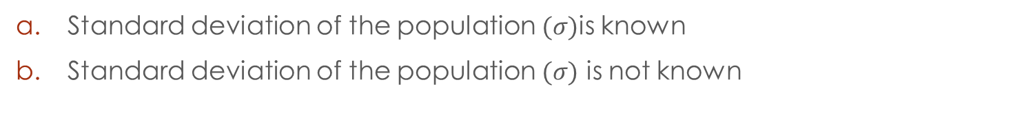
Confidence intervals Estimating a population mean
Standard deviation of the population $(σ)$is known
Standard deviation of the population $(σ)$ is not known

Slide 2
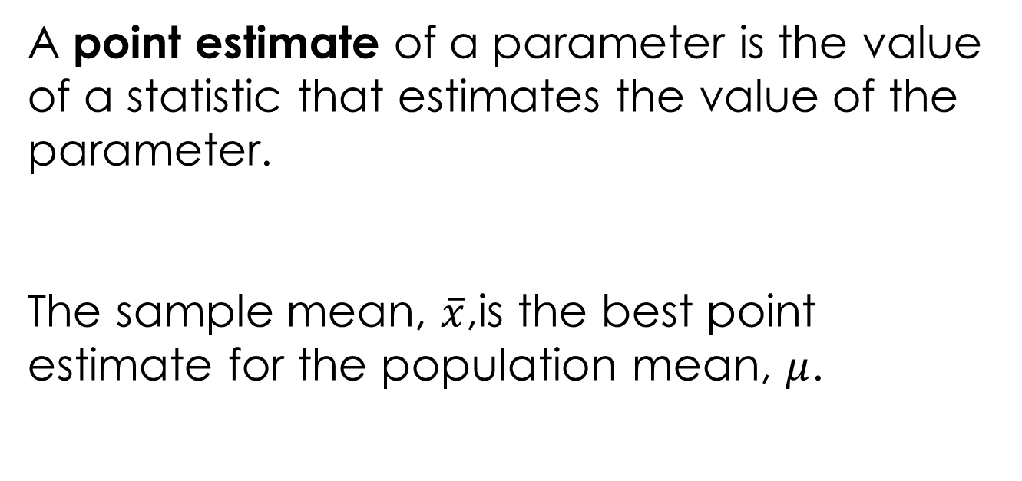
A point estimate of a parameter is the value of a statistic that estimates the value of the parameter.
The sample mean, $\overline{x}$,is the best point estimate for the population mean, $μ$.

Slide 3
A confidence interval estimate of a parameter consists of an interval of numbers along with a probability ( a level of confidence) that the interval contains the unknown parameter.

Slide 4
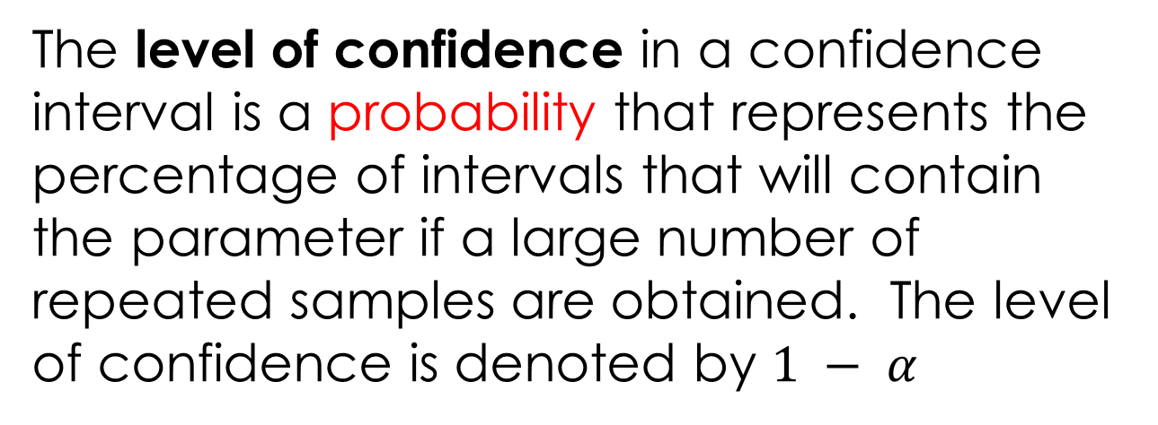
The level of confidence in a confidence interval is a probability that represents the percentage of intervals that will contain the parameter if a large number of repeated samples are obtained. The level of confidence is denoted by $1 − α$
E
For example, a 95% level of confidence would mean that if 100 confidence intervals were constructed, each based on a different sample from the same population, we would expect 95 of the intervals to contain the population mean.

Slide 5
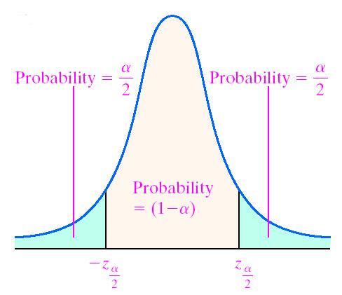
The level of confidence
${±z}_{\frac{α}{2}}$ represents the confidence coefficient or the critical value

Slide 6
The most used values for the degrees of confidence are: 90%, 95% and 99%.

Slide 7
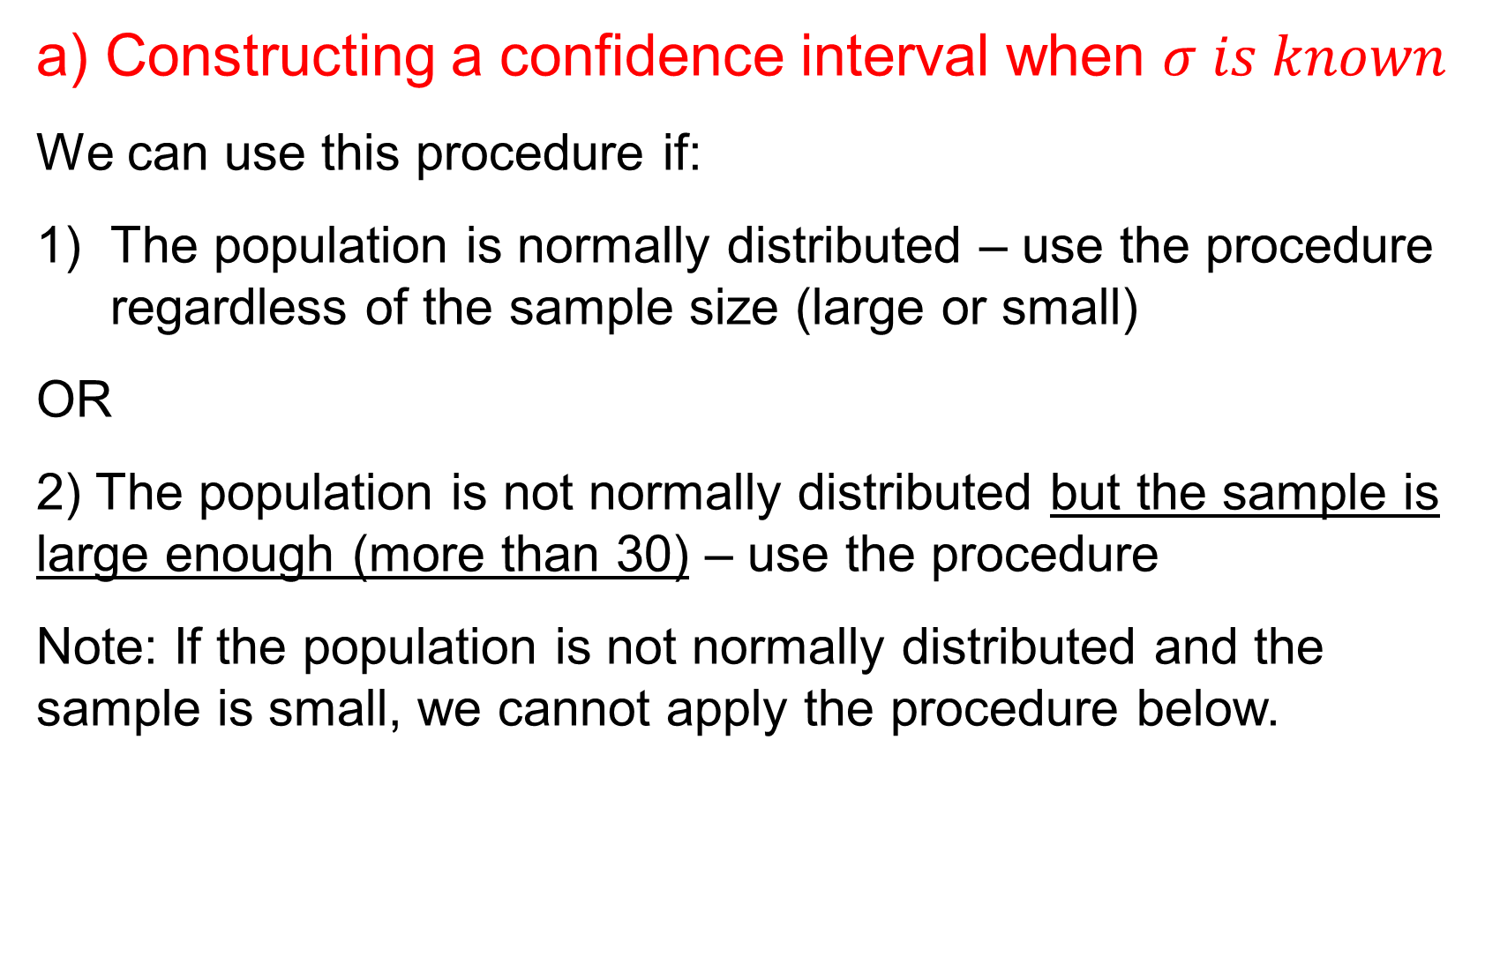
a) Constructing a confidence interval when $σ is known$
We can use this procedure if:
The population is normally distributed – use the procedure regardless of the sample size (large or small)
OR
2) The population is not normally distributed but the sample is large enough (more than 30) – use the procedure
Note: If the population is not normally distributed and the sample is small, we cannot apply the procedure below.

Slide 8
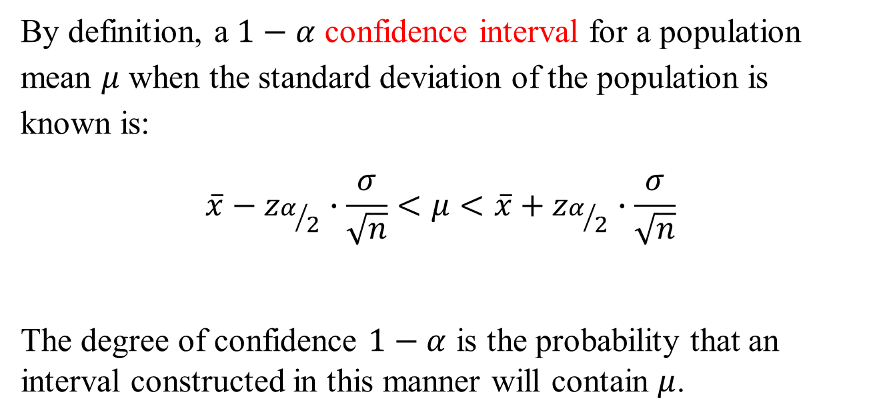
By definition, a $1−α$ confidence interval for a population mean $μ$ when the standard deviation of the population is known is:
$$\overline{x}−z_{α/2}∙\frac{σ}{\sqrt{n}}<μ<\overline{x}+z_{α/2}∙\frac{σ}{\sqrt{n}}$$
The degree of confidence $1−α$ is the probability that an interval constructed in this manner will contain $μ$.

Slide 9
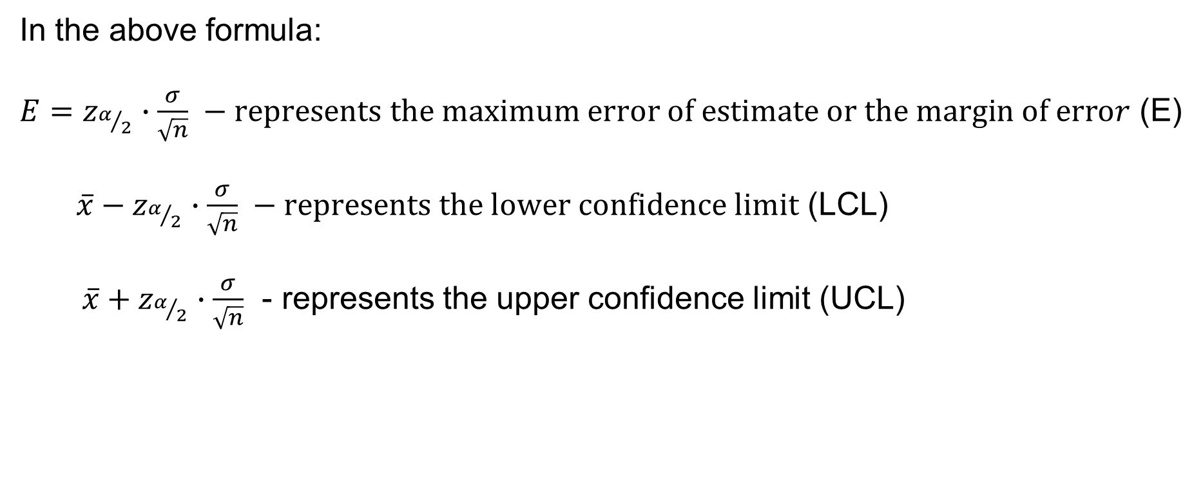
In the above formula:
${E=z}_{α/2}∙\frac{σ}{\sqrt{n}} −represents the maximum error of estimate or the margin of error$ (E)
$\overline{x}−z_{α/2}∙\frac{σ}{\sqrt{n}} −represents the lower confidence limit$ (LCL)
$\overline{x}+z_{α/2}∙\frac{σ}{\sqrt{n}}$ - represents the upper confidence limit (UCL)

Slide 10
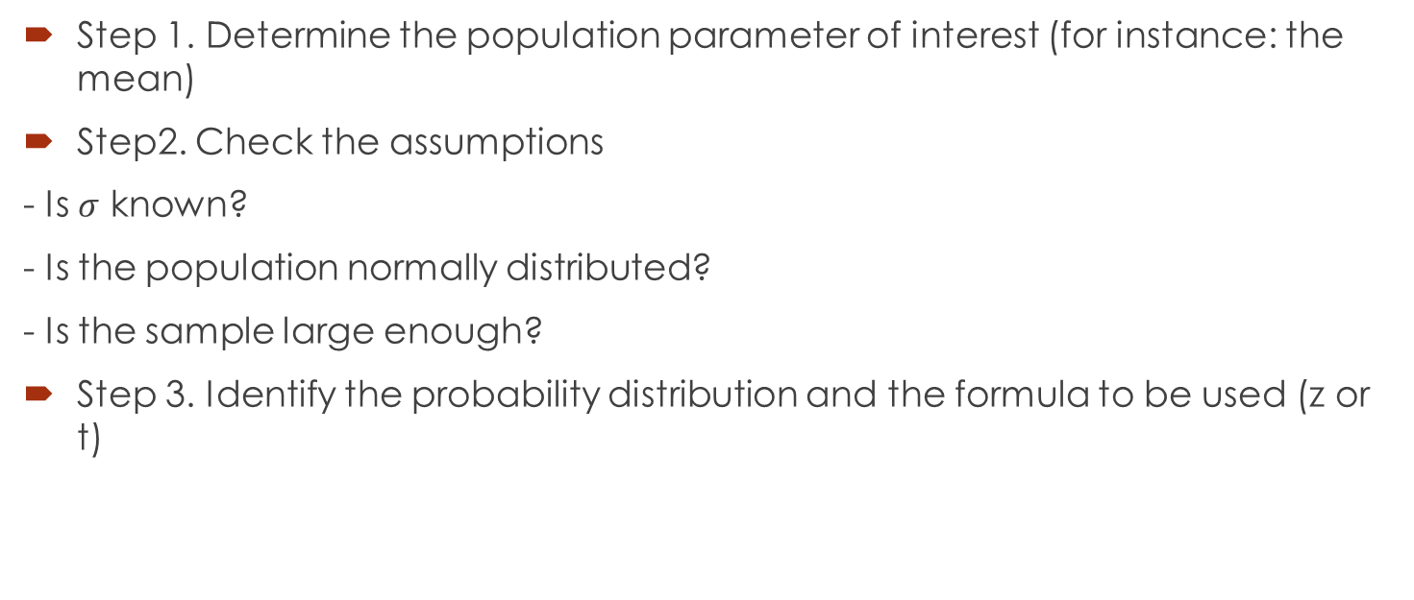
Steps for finding a confidence interval

Slide 11

Steps continued
Step 4. State the level of confidence and find the confidence coefficient ($z_{α/2}$or $t_{α/2})$
Step 5. Find the maximum error of estimate and state the confidence interval

Slide 12
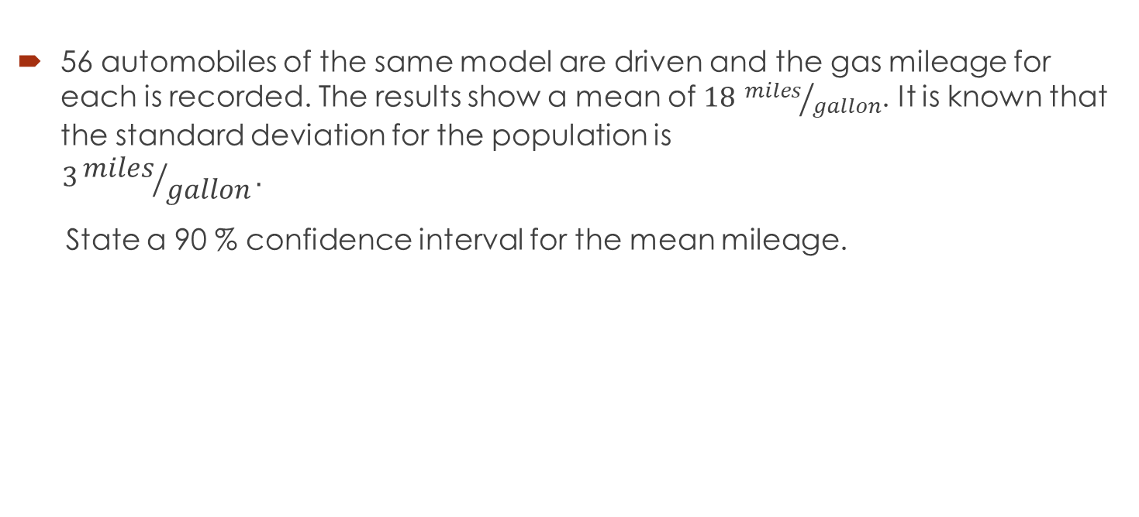
Example
E
56 automobiles of the same model are driven and the gas mileage for each is recorded. The results show a mean of $18$ ${miles}/{gallon}$. It is known that the standard deviation for the population is
$$3{miles}/{gallon}.$$
State a 90 % confidence interval for the mean mileage.

Slide 15
b) Constructing a confidence interval when sigma is not known (when we know s – the standard deviation of the sample
We can use this procedure if:
1) The population is normally distributed – use the procedure regardless of the sample size (large or small)
OR
2) The population is not normally distributed but the sample is large enough (more than 30)- use the procedure
Note: If the population is not normally distributed and the sample is small, we cannot apply the procedure below.

Slide 16
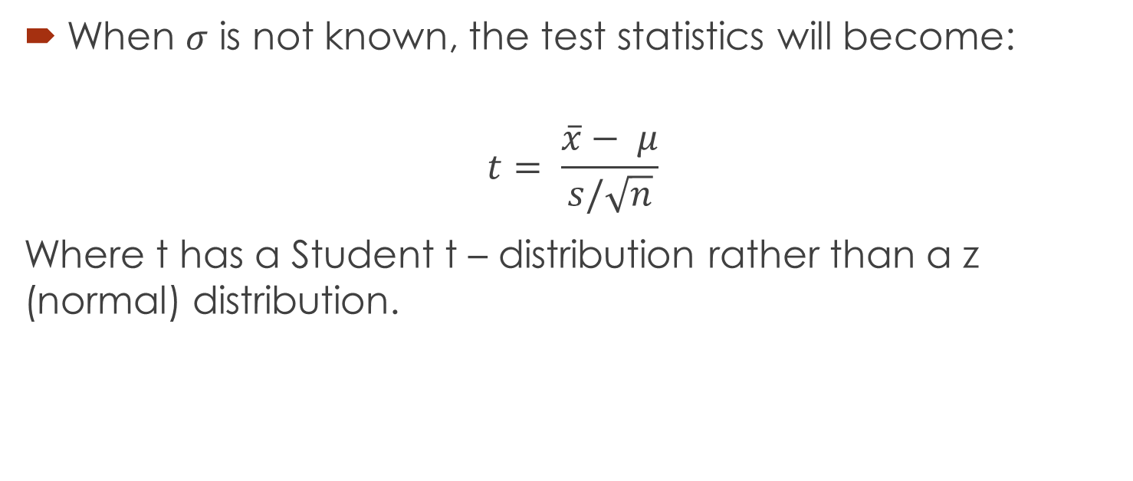
The new test statistic…
When $σ$ is not known, the test statistics will become:
$$t= \frac{\overline{x}− μ}{s/\sqrt{n}}$$
Where t has a Student t – distribution rather than a z (normal) distribution.

Slide 17
Properties of Student t - distribution
E
1) There are an infinite number of distributions, each of them having a number associated with it called the degrees of freedom. The number of degrees of freedom for a data set corresponds to the number of sample values that can vary after certain restrictions have been imposed on all data values.
Meaning: For instance, if we say that 10 students have scores with a mean of 80, then we can freely assign values to the first 9 scores, but the 10th score will be determined.
The number of degrees of freedom is df = n – 1

Slide 18
Properties continued
2) It follows that Student t-distribution is different for different sample sizes.
3) A t - distribution is similar to a normal distribution, being symmetrical to the vertical line through 0; the curve extends indefinitely to the right and to the left. The total area under the curve is 1.

Slide 19
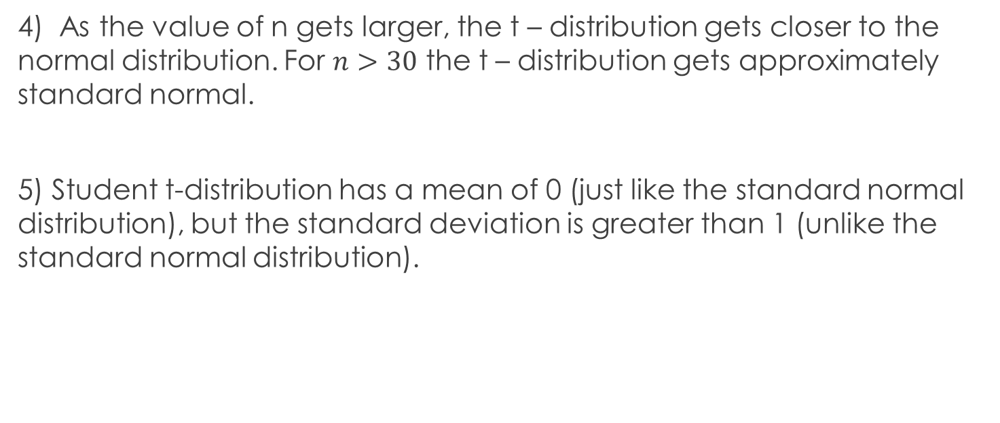
Properties continued
4) As the value of n gets larger, the t – distribution gets closer to the normal distribution. For $n>30$ the t – distribution gets approximately standard normal.
5) Student t-distribution has a mean of 0 (just like the standard normal distribution), but the standard deviation is greater than 1 (unlike the standard normal distribution).

Slide 20
t distribution
Z standard normal distribution

Slide 21
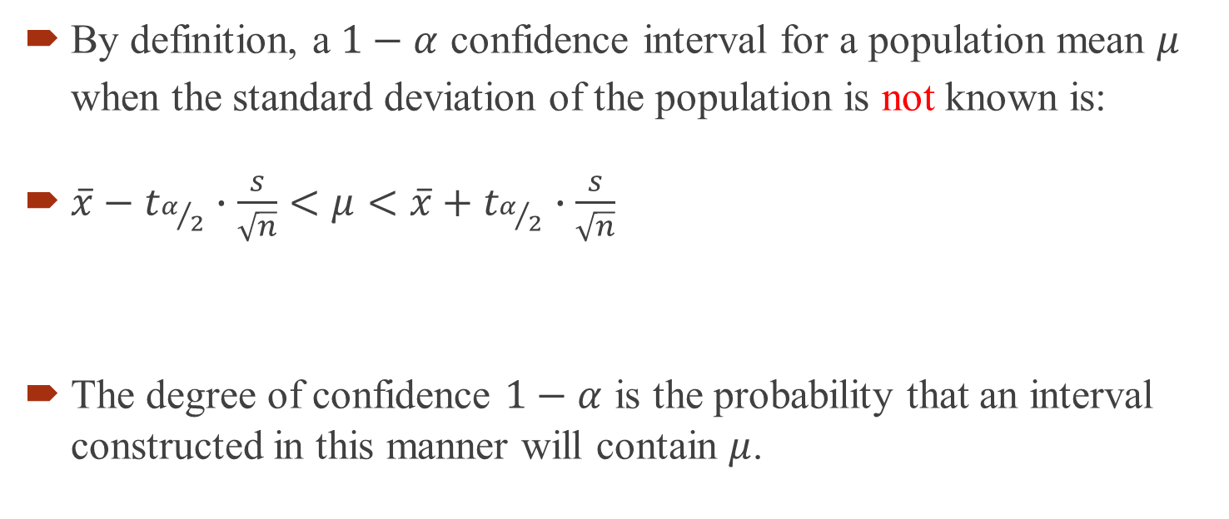
The confidence interval formula
By definition, a $1−α$ confidence interval for a population mean $μ$ when the standard deviation of the population is not known is:
$\overline{x}−t_{α/2}∙\frac{s}{\sqrt{n}}<μ<\overline{x}+t_{α/2}∙\frac{s}{\sqrt{n}}$
The degree of confidence $1−α$ is the probability that an interval constructed in this manner will contain $μ$.

Slide 22
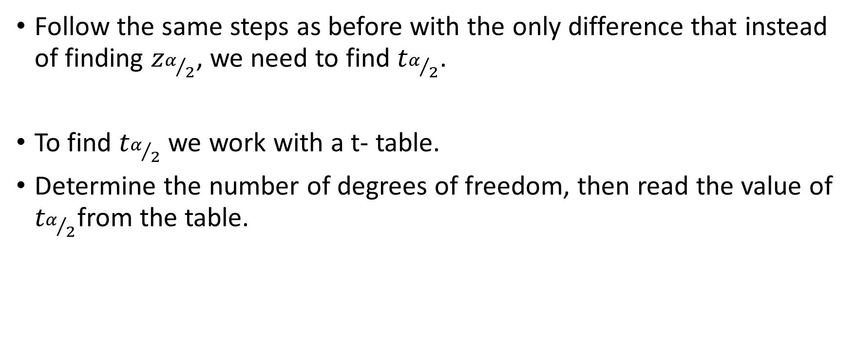

Steps for finding a confidence interval when $σ$ is not known
Follow the same steps as before with the only difference that instead of finding $z_{α/2}$, we need to find $t_{α/2}$.
To find $t_{α/2}$ we work with a t- table.
Determine the number of degrees of freedom, then read the value of $t_{α/2}$from the table.

Slide 23
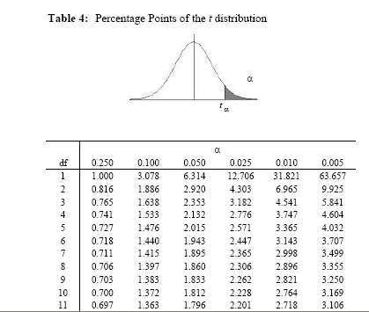

Example: Find the value of $t_{0.025}$for a sample size n = 7
Look up α
Look up df

Slide 24

Example
E
In a study of athletes, a psychologist administered a questionnaire, designed to measure the anxiety level to 20 athletes. The 20 scores for athletes gave $\overline{x}=65.2 and s=7.5$. Find the 95% confidence interval for the mean score $μ$ for the population of athletes from which the sample was obtained. If $μ$ is estimated by $\overline{x}$, find the maximum error of estimate with 95% level of confidence. Assume the population is approximately normal.

Slide 26
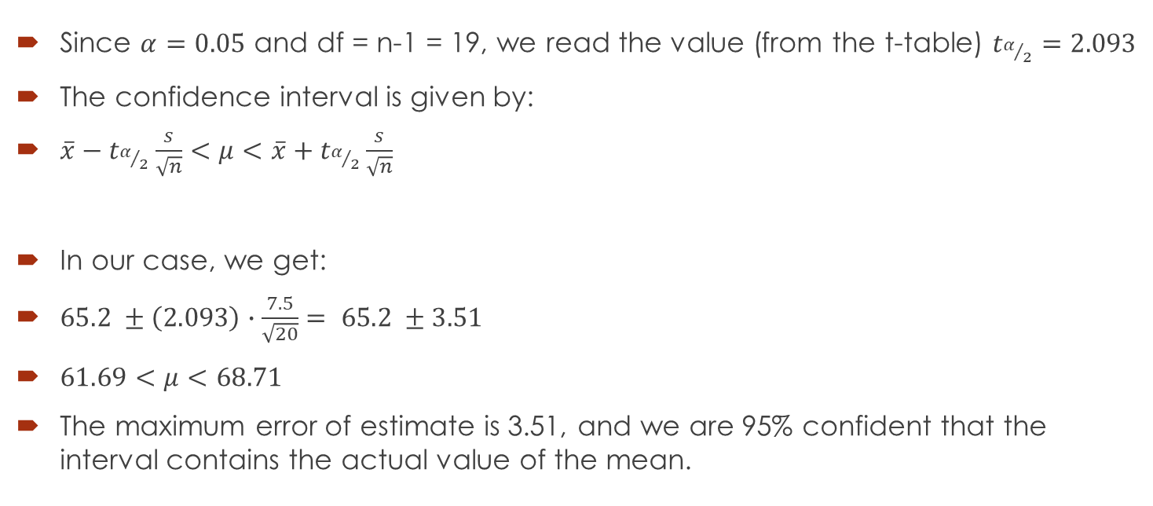
Solution
Since $α=0.05$ and df = n-1 = 19, we read the value (from the t-table) $t_{α/2}=2.093$
The confidence interval is given by:
$\overline{x}−t_{α/2}\frac{s}{\sqrt{n}}<μ<\overline{x}+t_{α/2}\frac{s}{\sqrt{n}}$
In our case, we get:
$65.2 ±\left(2.093\right)∙\frac{7.5}{\sqrt{20}}= 65.2 ±3.51$
$61.69<μ<68.71$
The maximum error of estimate is 3.51, and we are 95% confident that the interval contains the actual value of the mean.

Slide 27
Question 1
A study of 30 English professors found that they spent on average 12. 6 minutes correcting a paper. If the standard deviation for the population of times spent on correcting a paper is 2.5 minutes, find the 90% confidence interval for the mean of all papers. Consider a normally distributed population.

Slide 29
Question 2
Average score obtained by 25 students in a test is 75. It is known that the standard deviation of the population of scores is 8. Find the confidence interval at 95% confidence level, assuming the scores are normally distributed.

Slide 31
Question 2 – modified
Average score obtained by 25 students in a test is 75. The standard deviation for the sample of scores is 8. Find the confidence interval at 95% confidence level, assuming the scores are normally distributed.

Slide 33
Question 3
21 employees from a certain company travel to work an average of 14.3 miles. The standard deviation of their travel time was 2 miles. Find the 95% confidence interval of the true mean of the population, considering the data is normally distributed.

Slide 35
Question 4
The average yearly income for 17 engineering graduates in 2008 was $56,718. The standard deviation for the population of incomes is known to be $650. Find the 90% confidence interval for the population mean, considering the population is normally distributed.

Slide 37
Question 5
25 eggs were randomly chosen from female salmon and individually weighed. The mean weight was 0.978 g with a standard deviation of 0.042. Find the 95% confidence interval for the mean weight of the salmon eggs.

Slide 39
Question 6
An automotive engineer wants to estimate the cost of repairing a car that experiences a head-on collision. He crashes 36 cars, and the average repair is $11,000. The standard deviation of the population of repair costs is known to be $2,500.
Provide a 90% confidence interval for the true mean cost of repairs.
Provide a 98% confidence interval for the true mean cost of repair.

